Slide 1
JAVA
By Rahul Shrivastava

Slide 2
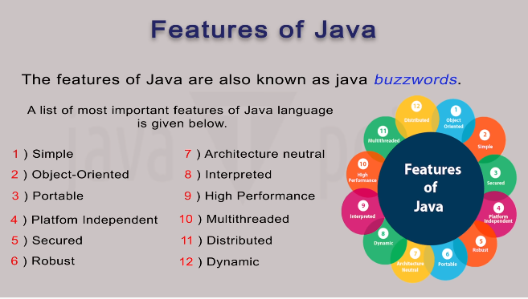

Slide 3
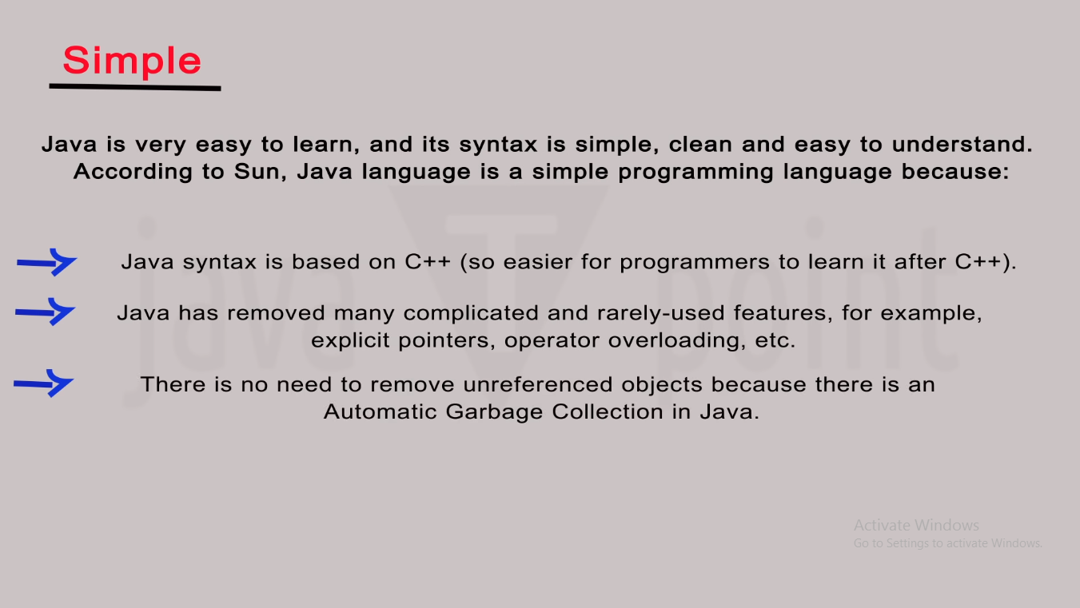

Slide 4
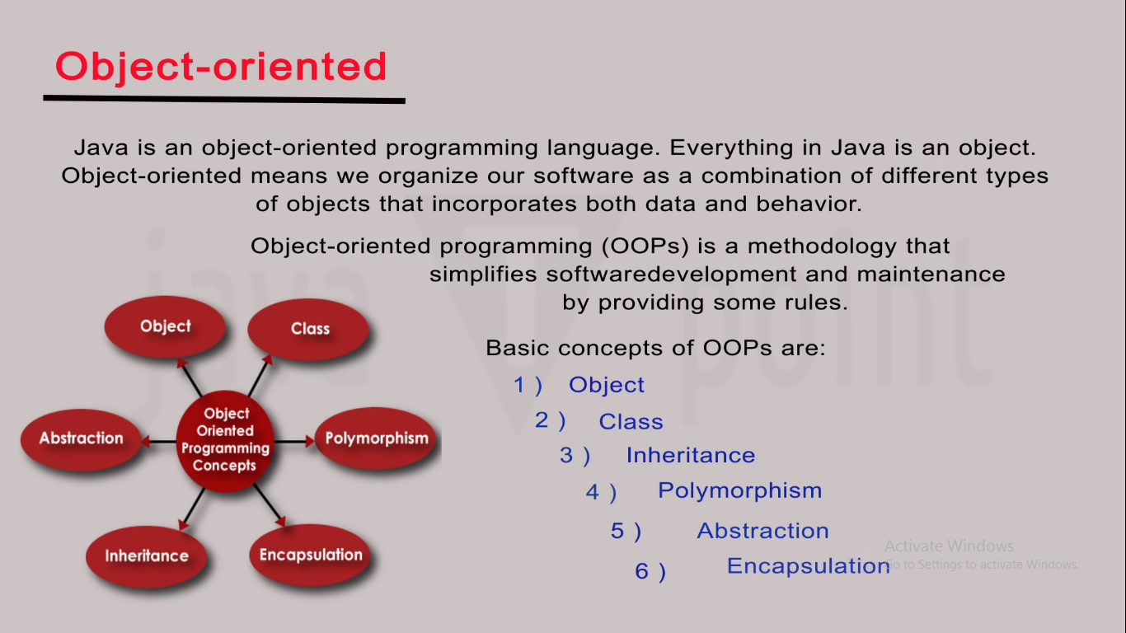

Slide 5
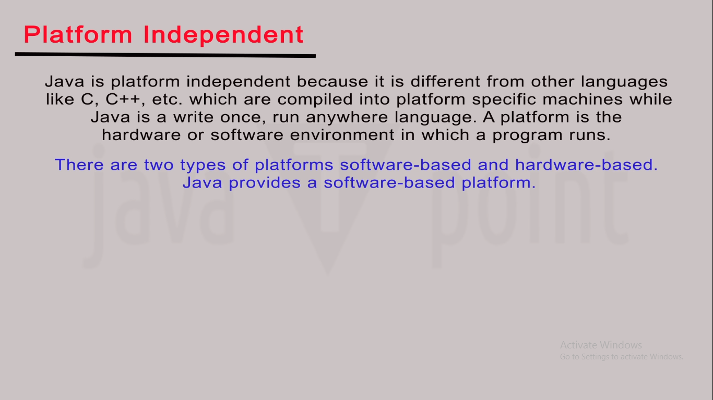

Slide 6
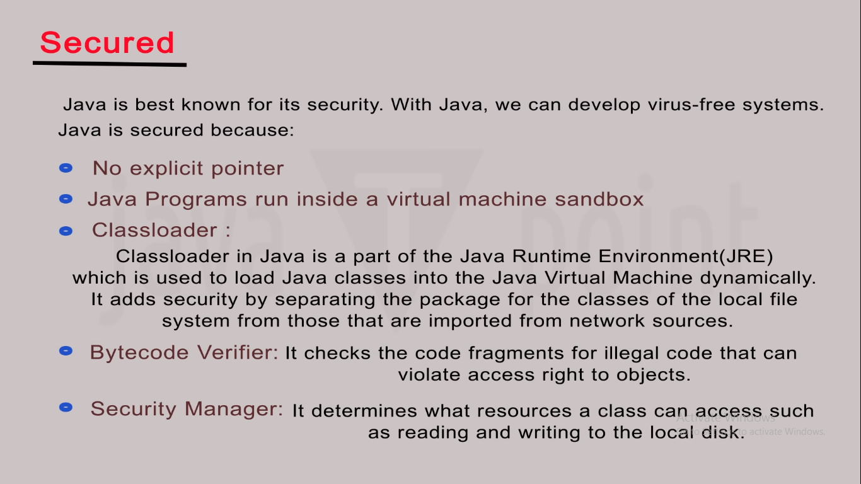

Slide 7
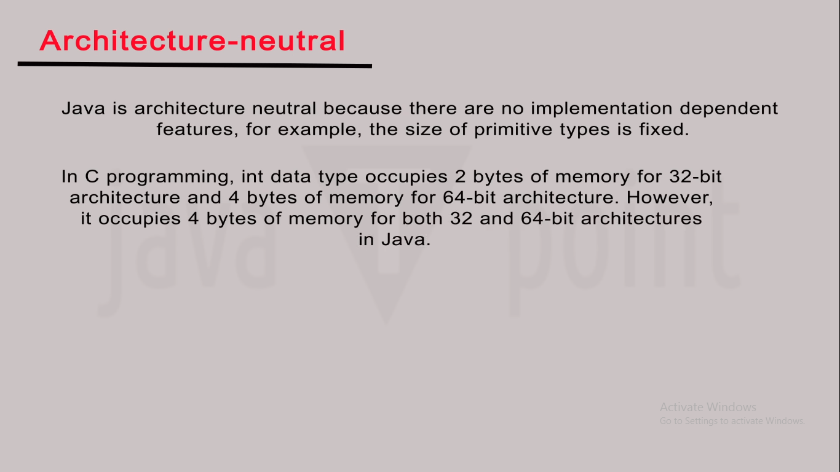

Slide 8
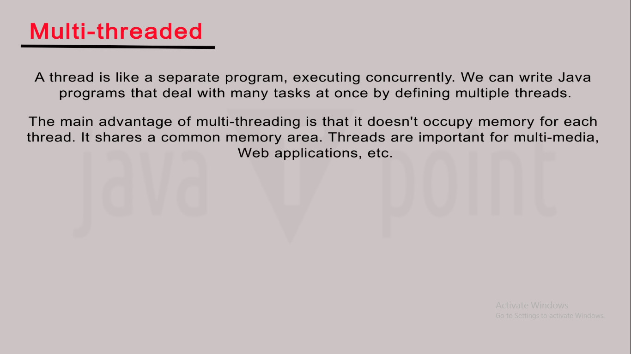
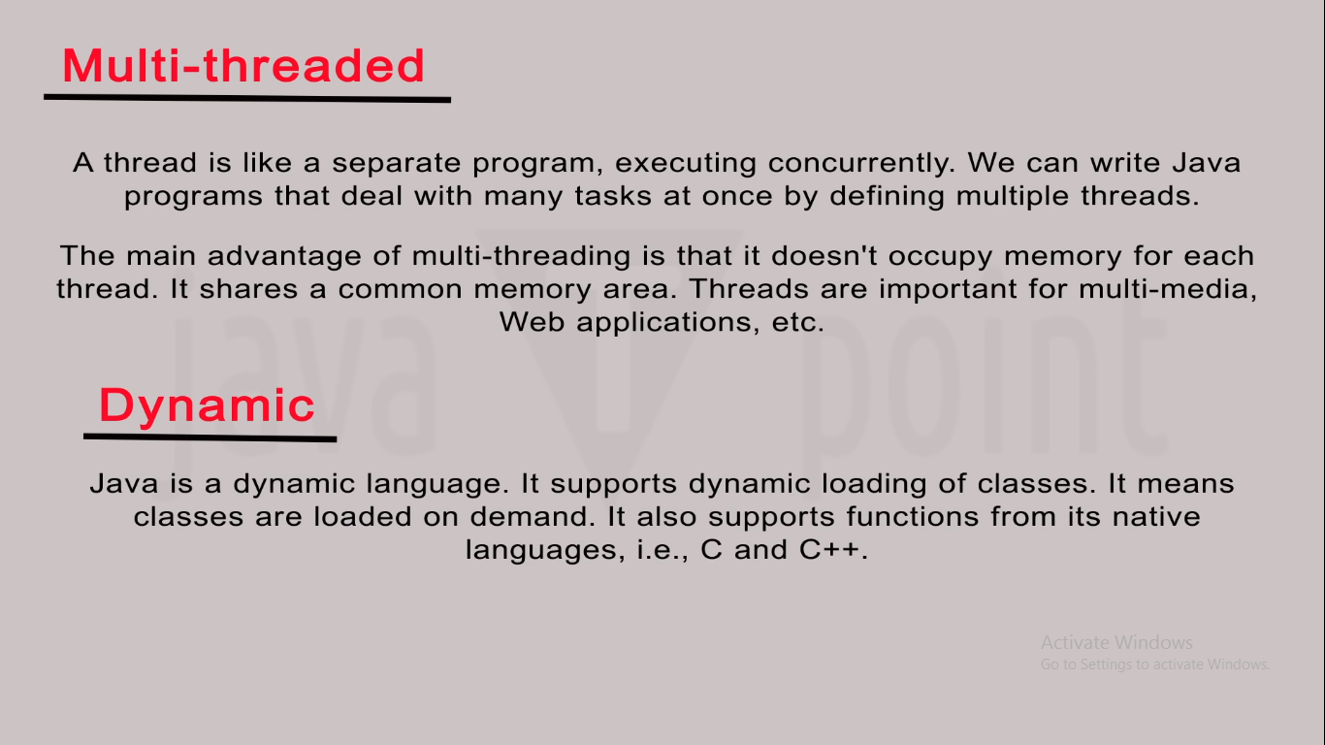

Slide 9
Working of Java Architecture
In Java, there is a process of compilation and interpretation.
The code written in Java, is converted into byte codes which is done by the Java Compiler.
The byte codes, then are converted into machine code by the JVM.
The Machine code is executed directly by the machine.

Slide 10
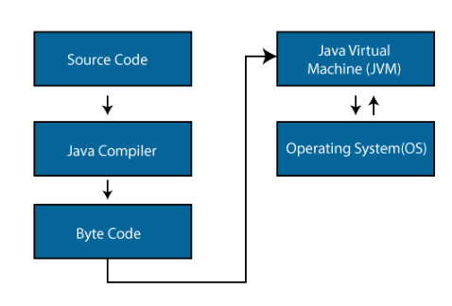

Slide 11
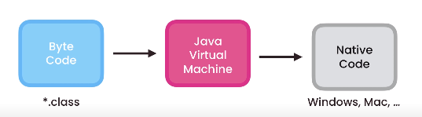

Slide 12
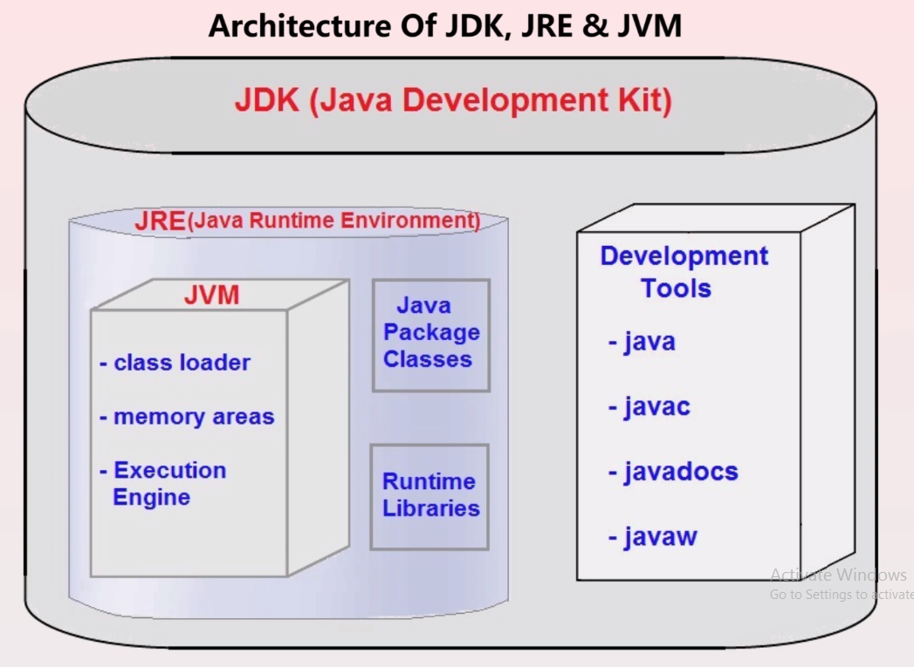
Components of Java Architecture

Slide 13
Java Development Tool Kit
Includes a complete JRE plus tools for developing, debugging, and monitoring Java applications.
JDK = Java Compiler + Development Tools + JRE

Slide 14
Java Virtual Machine:
Java applications are called WORA because of their ability to run a code on any platform.
This is done only because of JVM. The JVM is a Java platform component that provides an environment for executing Java programs.
JVM interprets the bytecode into machine code which is executed in the machine in which the Java program runs.
It is platform dependent.

Slide 15
Class Loader: Class loader is a subsystem of JVM. It is used to load class files. Whenever we run the java program, class loader loads it first.
Class method area: It is one of the Data Area in JVM, in which Class data will be stored. Static Variables, Static Blocks, Static Methods, Instance Methods are stored in this area.
Heap: A heap is created when the JVM starts up. It may increase or decrease in size while the application runs.
Stack: JVM stack is known as a thread stack. It is a data area in the JVM memory which is created for a single execution thread. The JVM stack of a thread is used by the thread to store various elements i.e.; local variables, partial results, and data for calling method and returns.
Native stack: It subsumes all the native methods used in your application.

Slide 16
Anatomy of JAVA Program

Slide 17
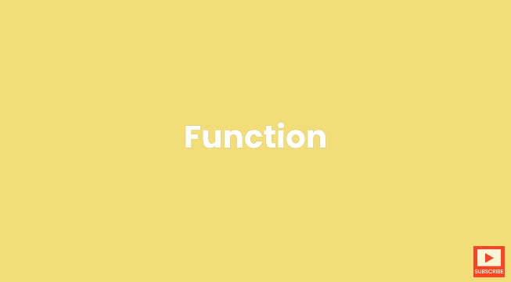

Slide 18
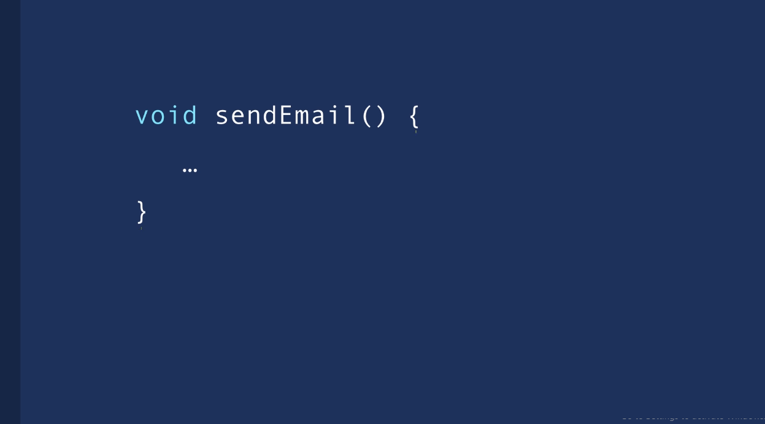

Slide 19
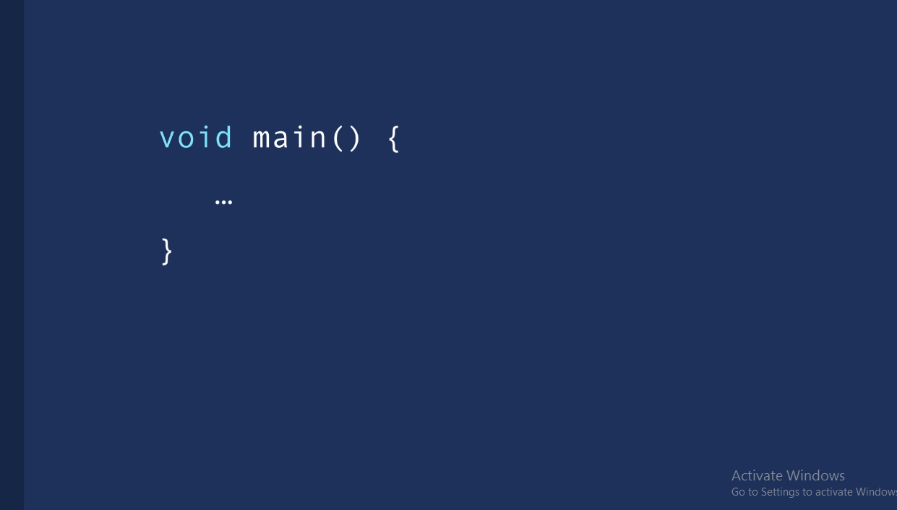

Slide 20
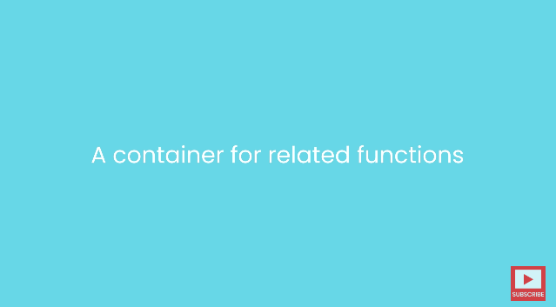

Slide 21
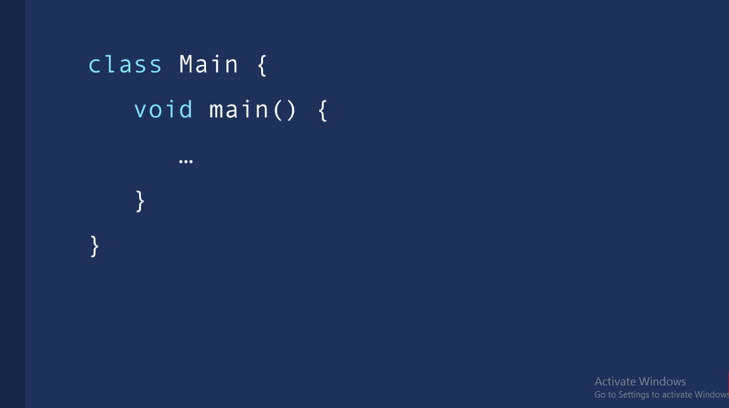

Slide 22
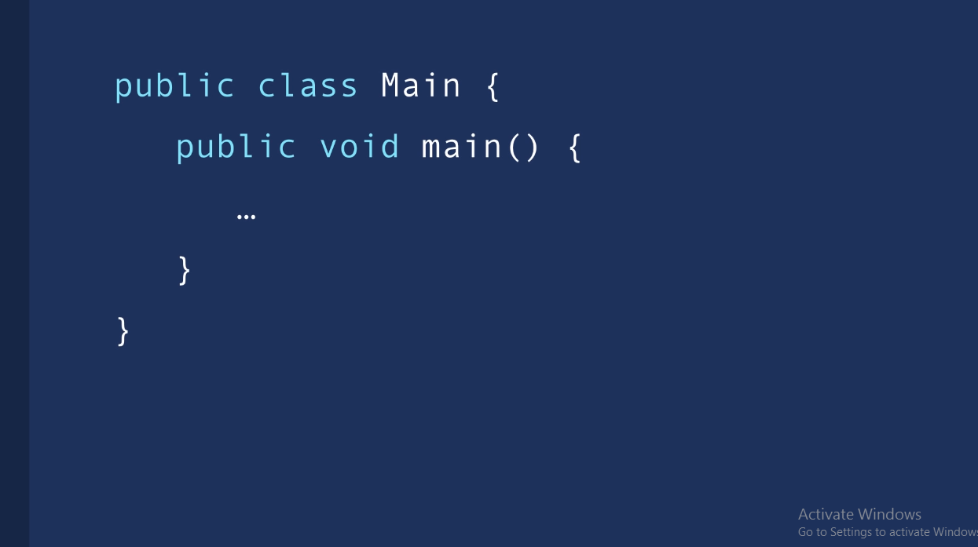

Slide 23
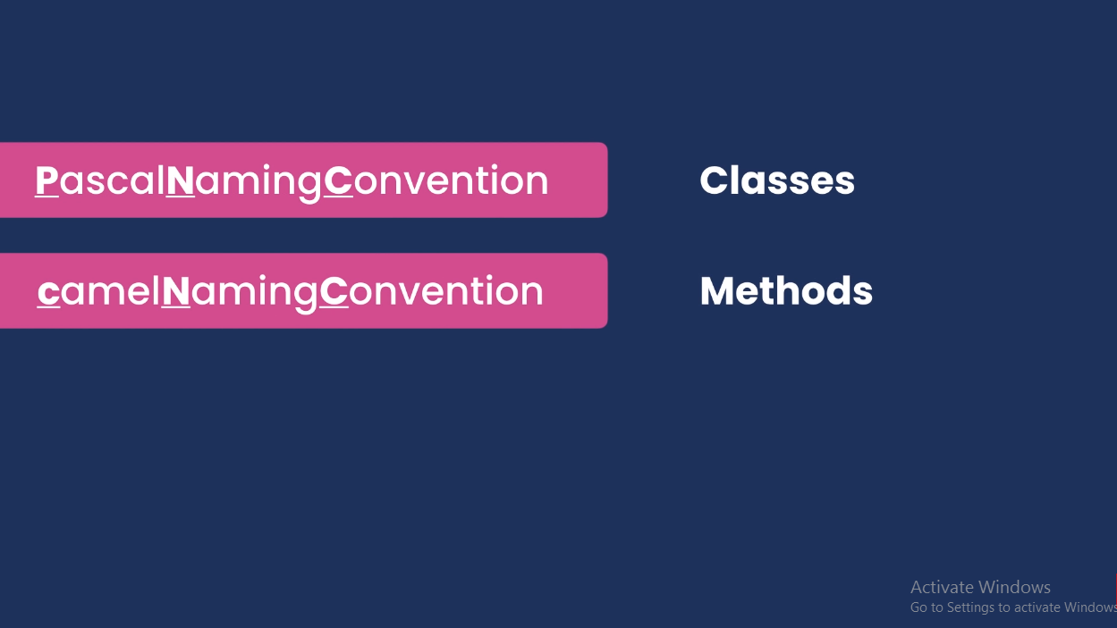

Slide 24


Slide 25
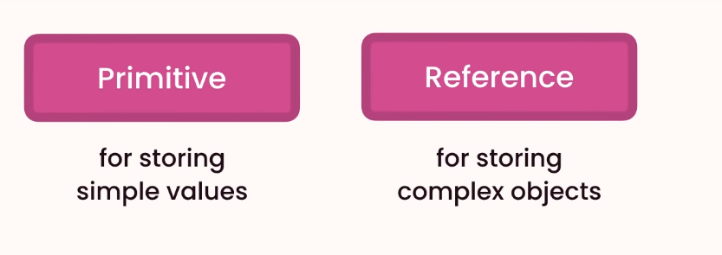

Slide 26
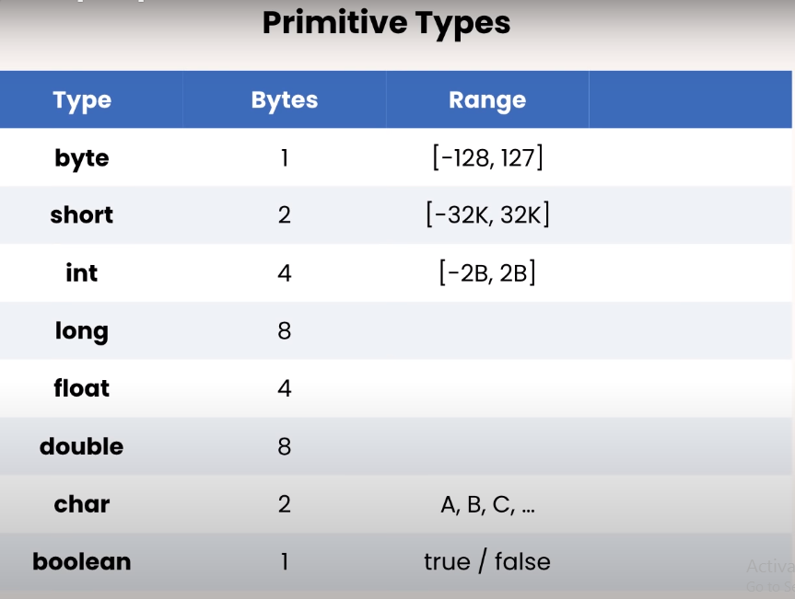

Slide 27
Reference Data Type

Slide 28
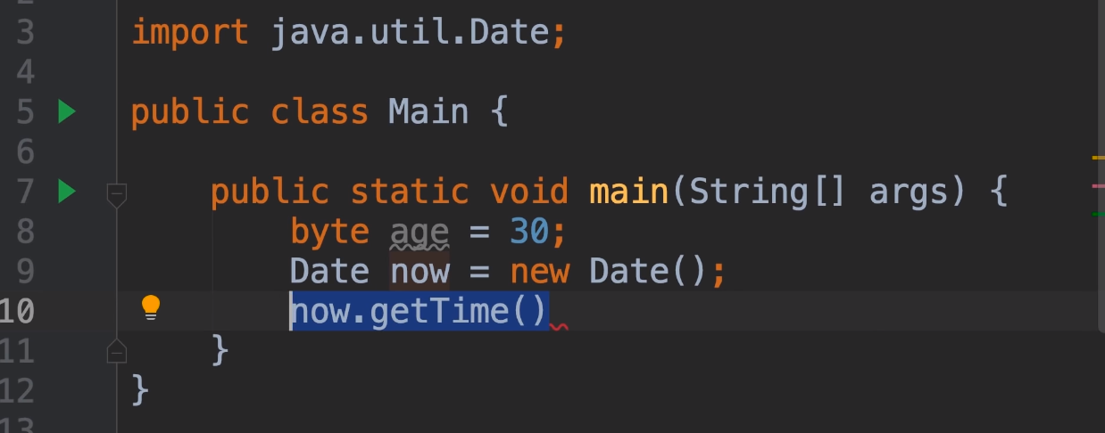

Slide 29
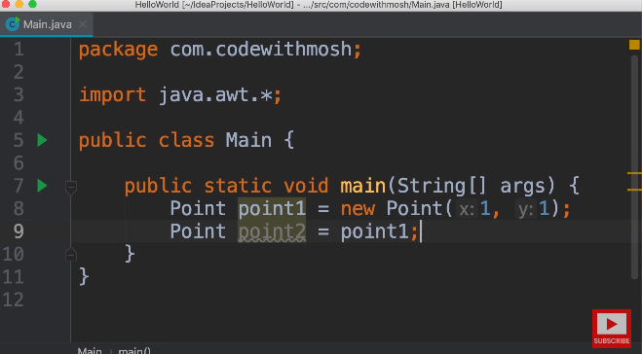

Slide 30
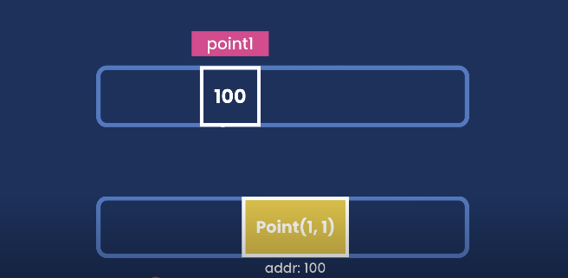

Slide 31
String

Slide 32
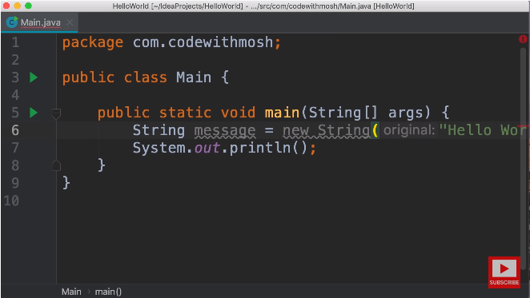

Slide 33
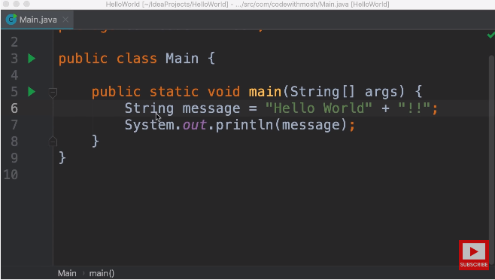

Slide 34
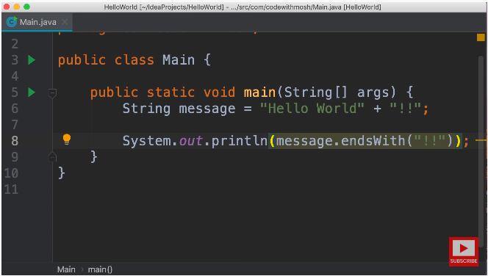

Slide 35
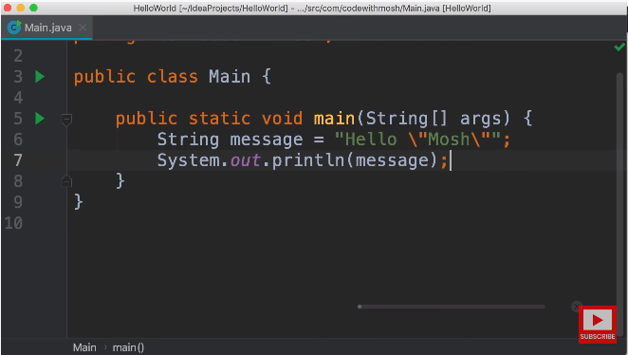

Slide 36
ARRAY

Slide 37
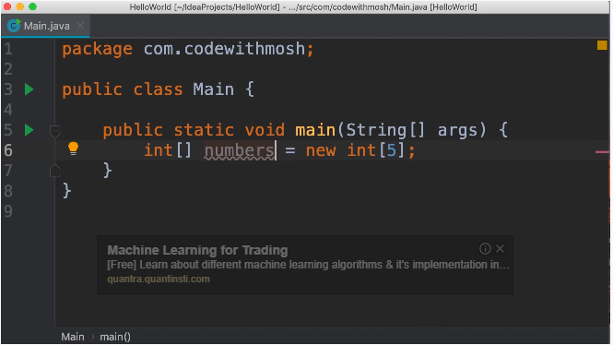

Slide 38
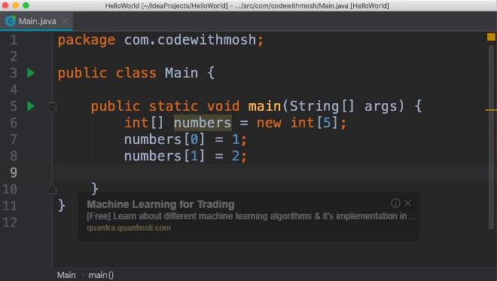

Slide 39
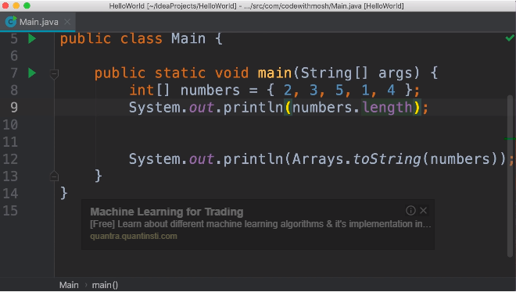

Slide 40
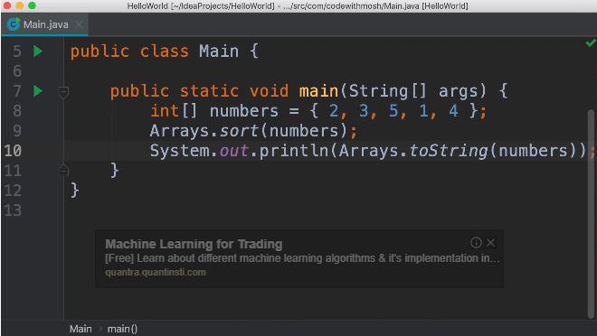

Slide 41
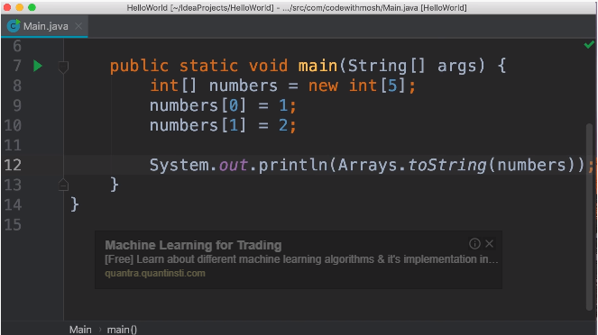

Slide 42
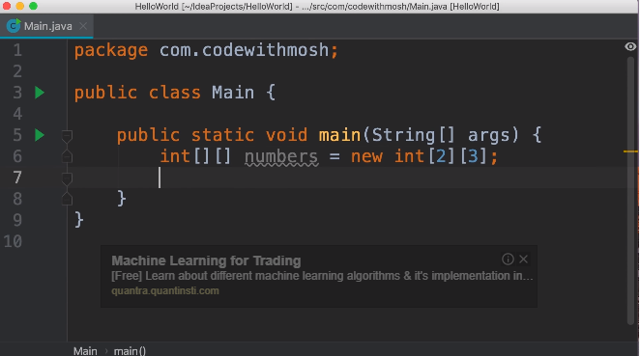

Slide 43
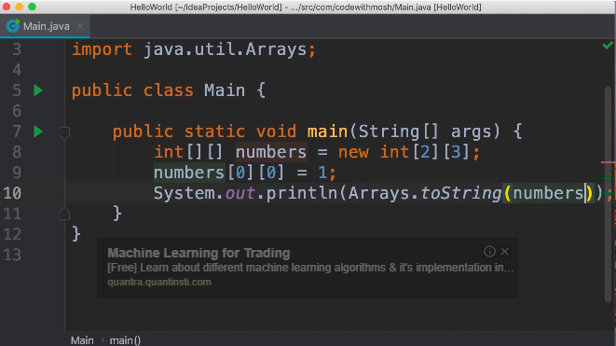

Slide 44
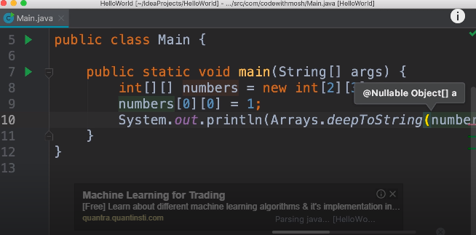

Slide 45
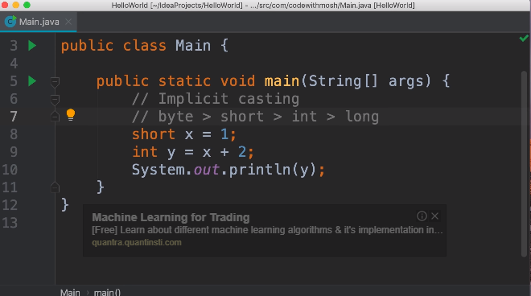

Slide 46
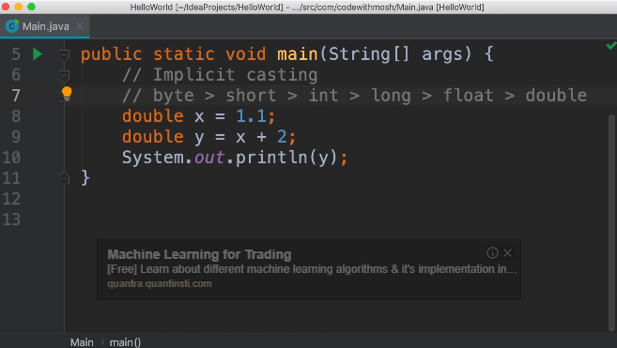

Slide 47
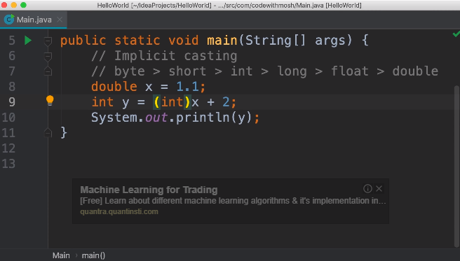

Slide 48
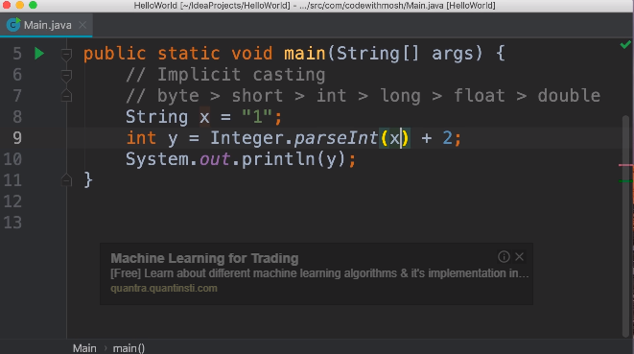

Slide 49
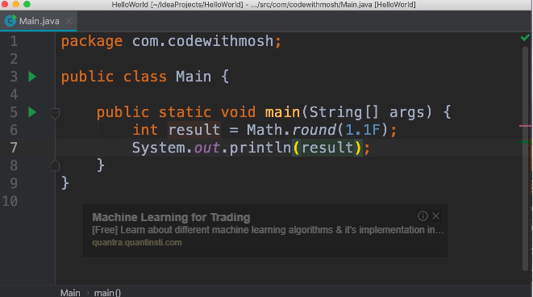

Slide 50
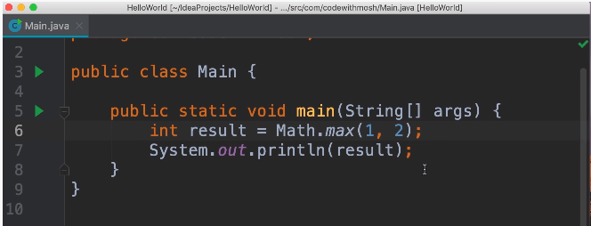

Slide 51
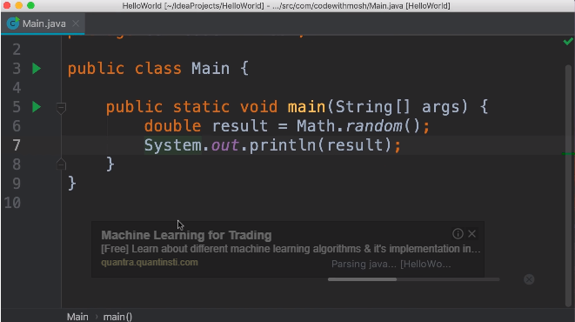

Slide 52
Scanner Class
Scanner is a class in java.util package used for obtaining the input of the primitive types like int, double, etc. and strings. It is the easiest way to read input in a Java program, though not very efficient if you want an input method for scenarios where time is a constraint like in competitive programming.
To create an object of Scanner class, we usually pass the predefined object System.in, which represents the standard input stream. We may pass an object of class File if we want to read input from a file.
To read numerical values of a certain data type XYZ, the function to use is nextXYZ(). For example, to read a value of type short, we can use nextShort()
To read strings, we use nextLine().
To read a single character, we use next().charAt(0). next() function returns the next token/word in the input as a string and charAt(0) function returns the first character in that string.

Slide 53
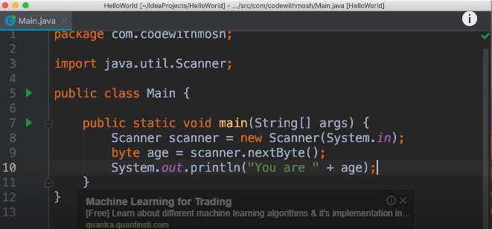

Slide 54
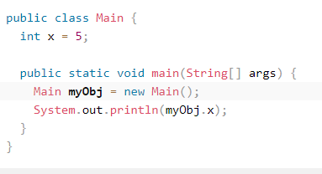
Class and Object

Slide 55
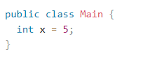
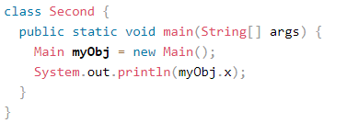
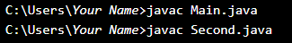
Multiple Classes

Slide 56
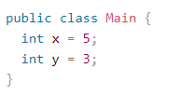
Class Attributes

Slide 57
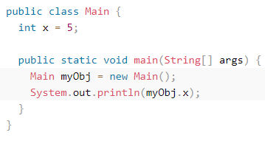
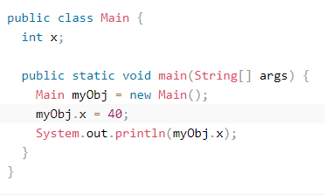
Accessing Attributes
You can access attributes by creating an object of the class, and by using the dot syntax (.):
The following example will create an object of the Main class, with the name myObj.
We use the x attribute on the object to print its value:
Example

Slide 58

Final Keyword

Slide 59

Multiple attribute and objects

Slide 60
Static vs. Non-Static
You will often see Java programs that have either static or public attributes and methods.
In the example above, we created a static method, which means that it can be accessed without
creating an object of the class, unlike public, which can only be accessed by objects:

Slide 61


Slide 62
Constructor
A constructor in Java is a special method that is used to initialize objects. The constructor is called when an object of a class is created. It can be used to set initial values for object attributes:

Slide 63

Constructor

Slide 64

Access Modifiers - controls the access level

Slide 65

Modifier for methods

Slide 66

Non Access Modifier for class

Slide 67

Non access modifier for methods and attributes

Slide 68


Slide 69
Encapsulation
The meaning of Encapsulation, is to make sure that
"sensitive" data is hidden from users. To achieve this, you must:
declare class variables/attributes as private
provide public get and set methods to access and update
the value of a private variable

Slide 70
Get and Set
You learned from the previous chapter that private variables can only be
accessed within the same class (an outside class has no access to it).
However, it is possible to access them if we provide public get and set
methods.The get method returns the variable value, and the set method
sets the value.

Slide 71


Slide 72


Slide 73



Slide 74
Why Encapsulation?
Better control of class attributes and methods
Class attributes can be made read-only (if you only use the get method),
or write-only (if you only use the set method)
Flexible: the programmer can change one part of the code without
affecting other parts
Increased security of data

Slide 75
Java Packages
A package in Java is used to group related classes. Think of it as a folder in a file directory. We use packages to avoid name conflicts, and to write a better maintainable code. Packages are divided into two categories:
Built-in Packages (packages from the Java API)
User-defined Packages (create your own packages)

Slide 76
Built-in Packages
The Java API is a library of prewritten classes, that are free to use, included in the Java Development Environment.
The library is divided into packages and classes. Meaning you can either import a single class (along with its methods and attributes), or a whole package that contain all the classes that belong to the specified package.

Slide 77



In the example above, java.util is a package, while Scanner is a class of the java.util package.

Slide 78

User-defined Packages
To create your own package, you need to understand that Java uses a file system directory to store them. Just like folders on your computer:

Slide 79

Example

Slide 80
Advantage of Java Package
1) Java package is used to categorize the classes and interfaces so that they can be easily maintained.
2) Java package provides access protection.
3) Java package removes naming collision.

Slide 81


Slide 82



Slide 83

Import a package in another package

Slide 84

Import a class of one package in another package

Slide 85

Import using fully qualified name

Slide 86

Create a sub-package in a package

Slide 87
Java Inheritance (Subclass and Superclass)
In Java, it is possible to inherit attributes and methods from one class to another. We group the "inheritance concept" into two categories:
subclass (child) - the class that inherits from another class
superclass (parent) - the class being inherited from
To inherit from a class, use the extends keyword.

Slide 88

Inheritance

Slide 89

Inheritance

Slide 90


Slide 91


Slide 92


Slide 93

Method Over-ridding
If subclass (child class) has the same method as declared in the parent class, it is known as method overriding in Java.
In other words, If a subclass provides the specific implementation of the method that has been declared by one of its parent class, it is known as method overriding.

Slide 94

Deadly Diamond problem
The "diamond problem" (sometimes referred to as the "Deadly Diamond of Death") is an ambiguity that arises when two classes B and C inherit from A, and class D inherits from both B and C. If there is a method in A that B and C have overridden, and D does not override it, then which version of the method does D inherit: that of B, or that of C?

Slide 95
Method Overloading in Java
If a class has multiple methods having same name but different in parameters, it is known as Method Overloading.
If we have to perform only one operation, having same name of the methods increases the readability of the program.
Suppose you have to perform addition of the given numbers but there can be any number of arguments, if you write the method such as a(int,int) for two parameters, and b(int,int,int) for three parameters then it may be difficult for you as well as other programmers to understand the behavior of the method because its name differs.

Slide 96
Advantage of method overloading
Method overloading increases the readability of the program.
Different ways to overload the method
There are two ways to overload the method in java
By changing number of arguments
By changing the data type

Slide 97

Example of function overloading

Slide 98

Example of function overloading

Slide 99
Interface
An interface in Java is a blueprint of a class. It has static constants and abstract methods.
The interface in Java is a mechanism to achieve abstraction. There can be only abstract methods in the Java interface, not method body. It is used to achieve abstraction and multiple inheritance in Java.
In other words, you can say that interfaces can have abstract methods and variables. It cannot have a method body.
Java Interface also represents the IS-A relationship.
It cannot be instantiated just like the abstract class.

Slide 100

Interface

Slide 101

Interface Declaration
An interface is declared by using the interface keyword.
It provides total abstraction; means all the methods in an interface are declared with the empty body, and all the fields are public, static and final by default.
A class that implements an interface must implement all the methods declared in the interface.

Slide 102


Slide 103
Implements
An interface is an abstract "class" that is used to group related methods with "empty" bodies:
To access the interface methods, the interface must be "implemented" (kinda like inherited) by
another class with the implements keyword (instead of extends).
The body of the interface method is provided by the "implement" class:

Slide 104


Slide 105


